Slide 1


Student Management System: A Proof of Concept
This presentation introduces a Proof of Concept (POC) for a student management system designed to streamline student data management and analysis.
by Yeshwanth

Slide 2
System Overview: Student Management
Key Features
Data Fields
The system will include core features like adding, fetching, saving, searching, and deleting student data.
It will capture essential information such as USN, name, gender, CGPA, semester, date of birth, mobile numbers, and email.

Slide 3

Data Storage: Text File Approach
Simplicity
Portability
Text files offer a straightforward method for storing student data, requiring minimal setup.
Text files are easily transferable between systems, ensuring data accessibility across platforms.
Scalability
Security
While text files are suitable for smaller datasets, handling large-scale student data may necessitate alternative solutions.
Text files require careful handling to prevent unauthorized access and data breaches.

Slide 4
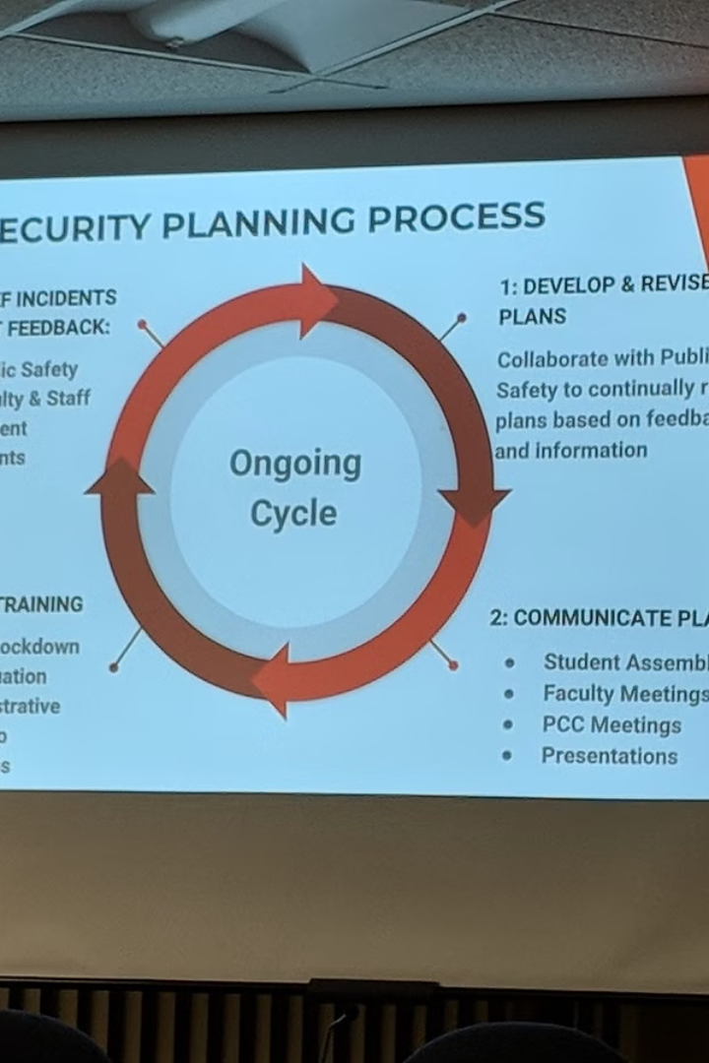




User Interface: A Visual Representation
Add Student
Search Student
Provides a user-friendly interface for adding new student data.
Allows users to search for specific student records based on their USN.
Save Updates
Delete Student
Enables users to update existing student data and save the changes.
Allows users to delete student records permanently from the system.

Slide 5





Functional Breakdown: Detailed Features
Add Student
1
Captures student details.
Fetch Data
2
Retrieves student information.
Save Updates
3
Modifies existing records.
Search Student
4
Locates specific students.
Delete Student
5
Removes records permanently.

Slide 6
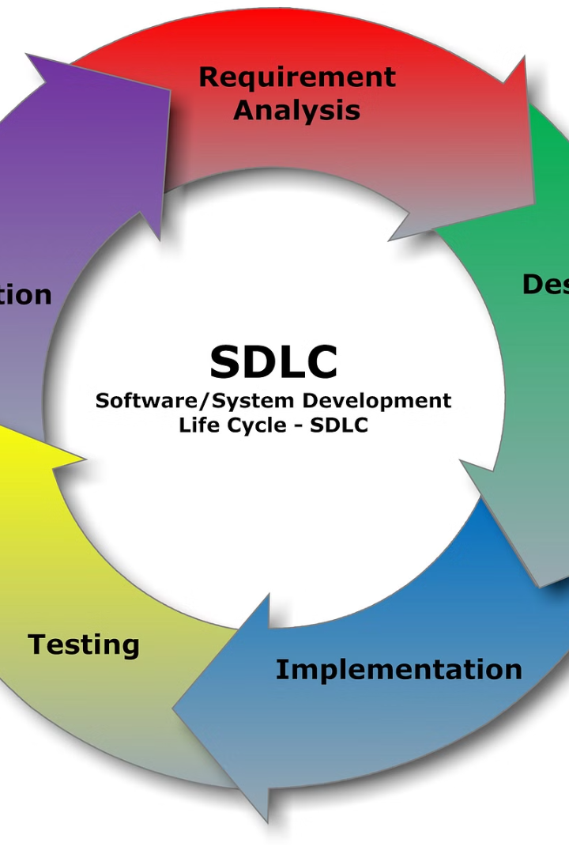
Future Enhancements: Optimizing the System
1
Database Integration
Transitioning to a database system for improved scalability and data management.
2
Web and Mobile Versions
Developing web and mobile applications to enhance user accessibility and convenience.
3
Data Security Measures
Implementing data encryption and authentication protocols to safeguard sensitive information.

Slide 7

Conclusion: A Promising Foundation
Proven Capabilities
Future Direction
The POC demonstrates the feasibility of developing a student management system that meets basic requirements.
Future enhancements, such as database integration and advanced security, will further enhance the system's capabilities.

Slide 8

Acknowledgments: Thank You to the Team
We extend our gratitude to Anu Ma'am for her guidance and support throughout this project. We also thank Dr. Man Cha Sir for his invaluable insights and encouragement. Special thanks to the GE team for their valuable feedback and contributions.

